Slide 1
Why Renewable Natural Gas
May 17, 2017

Slide 2
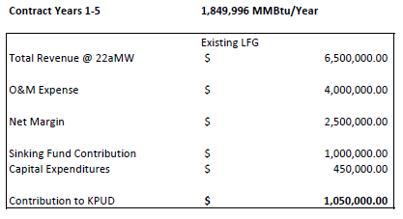
Electrical Generation

Slide 3
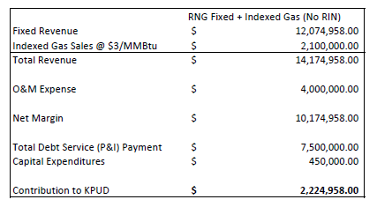
RNG Years 1 -5, no Renewable “Value”

Slide 4
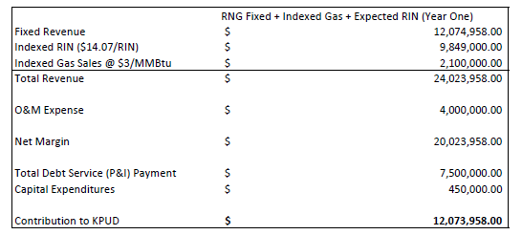
RNG Years 1-5 Potential Value
* Assumes $19 RIN / LCFS value. Currently $30.

Slide 5
History
Primary requirement was to improve net margins from the project and reduce our overall risk, which currently is the market risk faced for electricity sales.
Over the past three years, KPUD introduced legislation that was in Olympia to allow PUDs to produce and sell RNG, held discussions with over 80 companies, including 23 potential off-takers, visited 8 site visits, evaluated proposals, worked with engineers, equipment vendors, off-takers and manufacturers, industry associations, financial advisors and governmental representatives to develop our needs and arrive at suitable contracts for this project.

Slide 6
History
We explored everything from selling or closing the facility, to leasing it, to leasing the gas rights, to developing an RNG project ourselves.
Ultimately, we arrived at an agreement whereby we borrow the capital to make the improvements, but the off-takers provide financial security to reduce the risk to our rate payers. This provided the best balance of value and risk.
Improvements are about $35 million. We have financing through North Cascades Bank, which is a regional bank located in Wenatchee Washington. 3.5% for 5 years.

Slide 7
Contract Offtaker
The IGI Resources / British Petroleum contracts are the fourth formal MOU / contract discussions we have held. The first three did not provide the security and other needs we required.
IGI Resources is wholly owned by BP North America
Latest data I could find this morning, IGI Resources has sales of approx 600 million SCFM / day
Republic’s landfill produces about 6000 SCFM a day
BPNA is valued about $150 billion

Slide 8
IGI / BP Contract Terms
Contract Terms Summary:
15 Year Contract with 2 delivery periods
Delivery Period One- Years 1-5 where 1,149,996 MMBtu/year is purchased at fixed price of $10.50. Remaining gas purchased at 100% of index price and RINs purchased at 75% of index price.
Delivery Period Two – Years 6-15 where gas is purchased at 100% of index price with RINs purchased at 75% of index price.
RNG estimated to commence commercial operations 7/1/2018
Existing generation facility to operate at an estimated 22aMW Jan-June 2018

Slide 9
Financing
Financial Highlights:
KPUD staff has presented detailed financial analysis of RNG project potential outcomes over multiple meeting/workshops.
KPUD to finance project utilizing financing from regional bank at rate of 3.5%.
Upon project completion final loan balance to be repaid over 5 year term with debt service covered by portion of fixed price/volume contract.
Existing facility to contribute roughly $3M toward total 2018 site revenue.

Slide 10
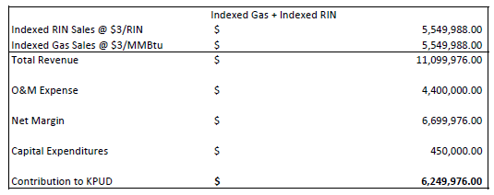
RNG Years 6-15

Slide 11
Electrical Generation

